Slide 1


Modelling the origin of polis in Anatolia. From conceptual to computational approaches.
CAA 2019 - S11: Pre-Modern Cities and Complexity
Dr. Dries Daems
Suna & Inan Kıraç Research Centre for Mediterranean Civilizations (Koç University)
Sagalassos Archaeological Research Project (KU Leuven)
dries.daems@kuleuven.be
Twitter: @DriesDaems

Slide 2
Contents
The polis in Anatolia
Designing models: What, how, why?
Conceptual modelling
Fusion-fission cycles
(Urban) scaling
Central place theory
From conceptual to computational models
Computational models: PolisABM

Slide 3
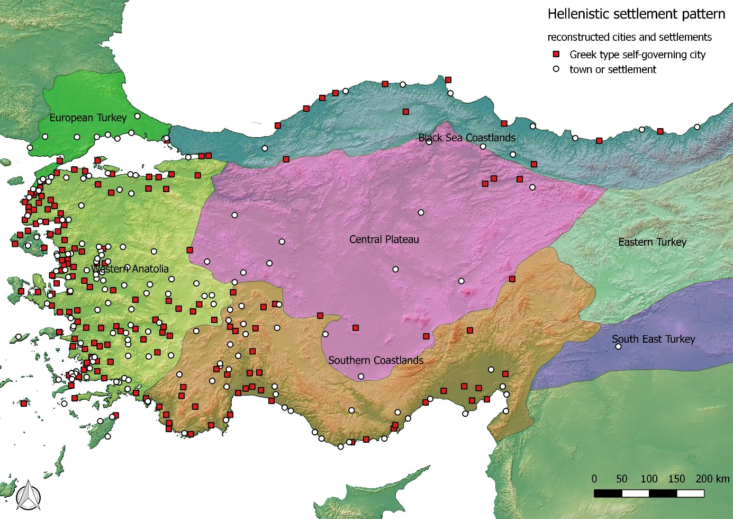
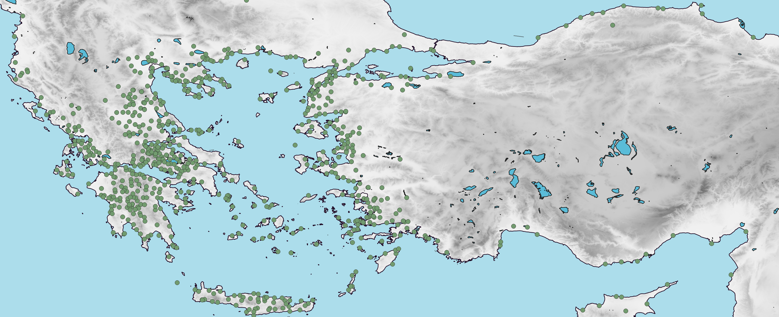
The Polis in Anatolia
Archaic and Achaemenid periods
Made by author with dataset from POLIS website of Stanford University (http://polis.stanford.edu/); based on Hansen and Nielsen 2004.
Map made by Willett (2019)
Hansen & Nielsen (2004) Inventory of Poleis
Willet 2019 The Geography of Urbanism in Roman Asia Minor
Notes:
On a macro level:
Hansen & Nielsen → Archaic and Classical times
Willet: Spread of poleis land inward in Hellenistic times

Slide 4
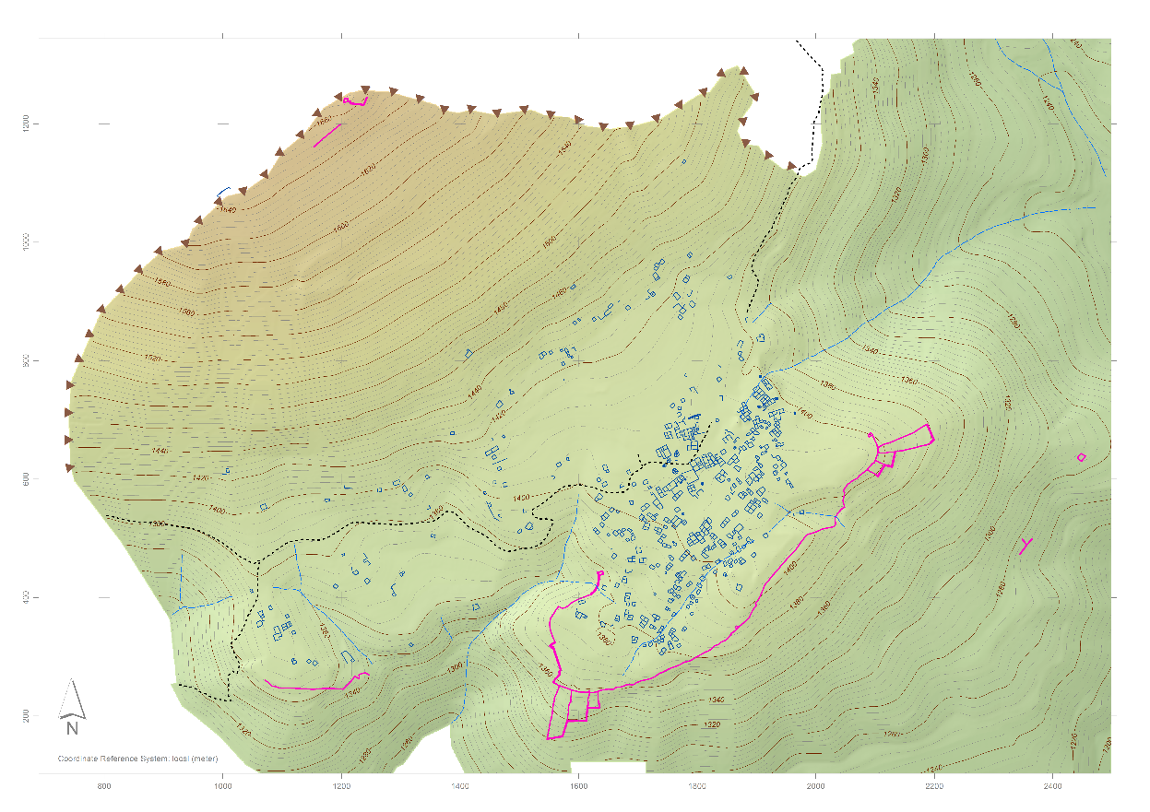
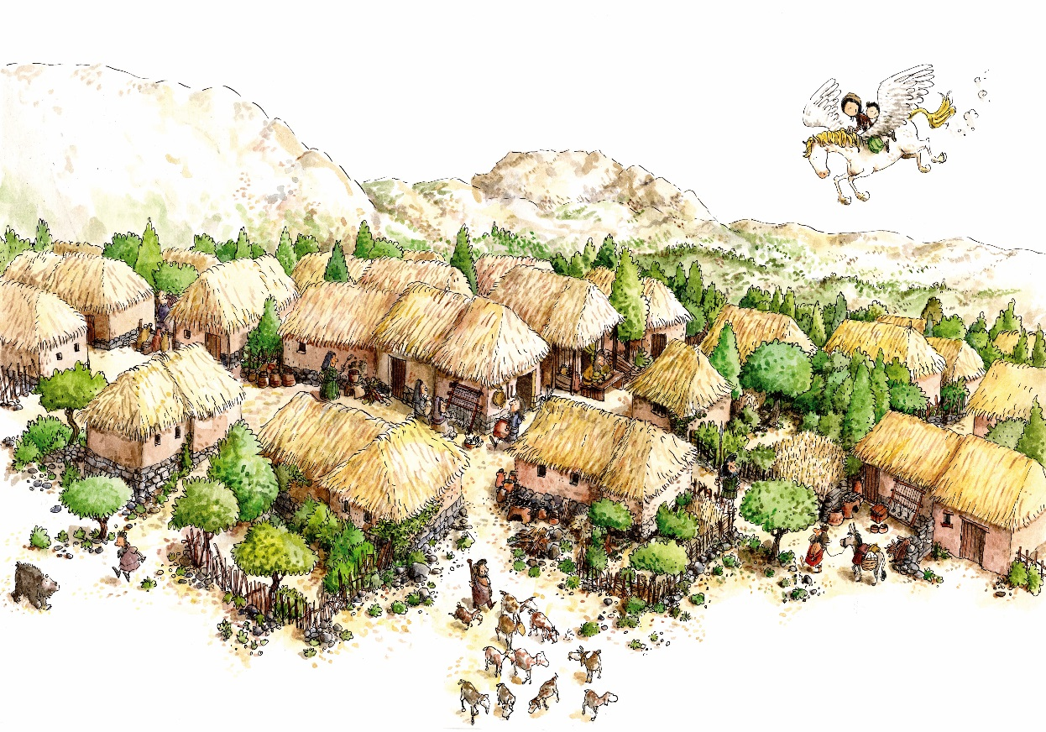
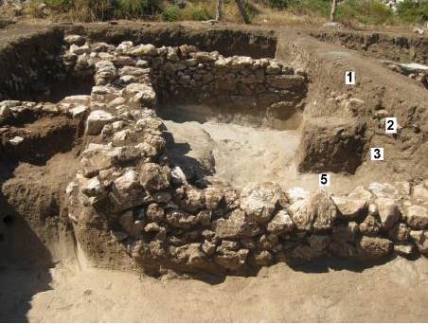
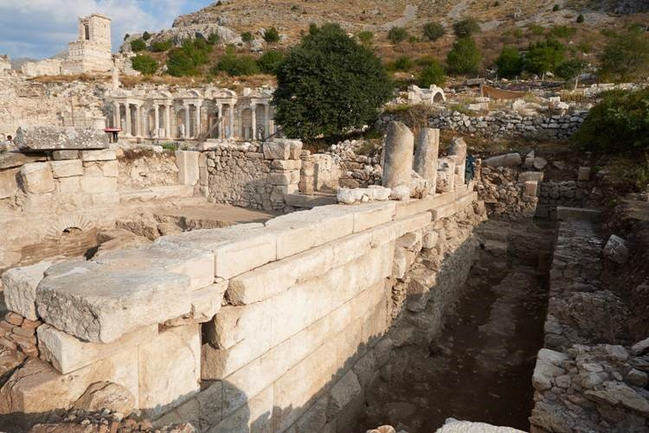
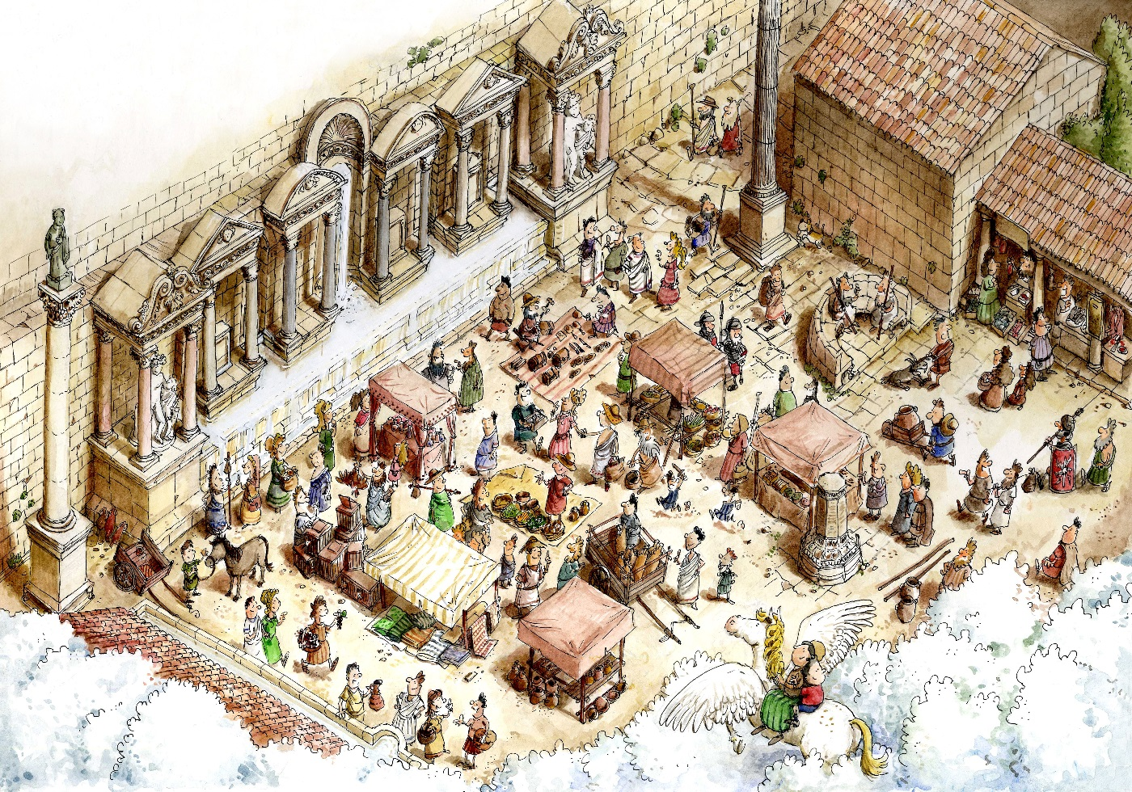
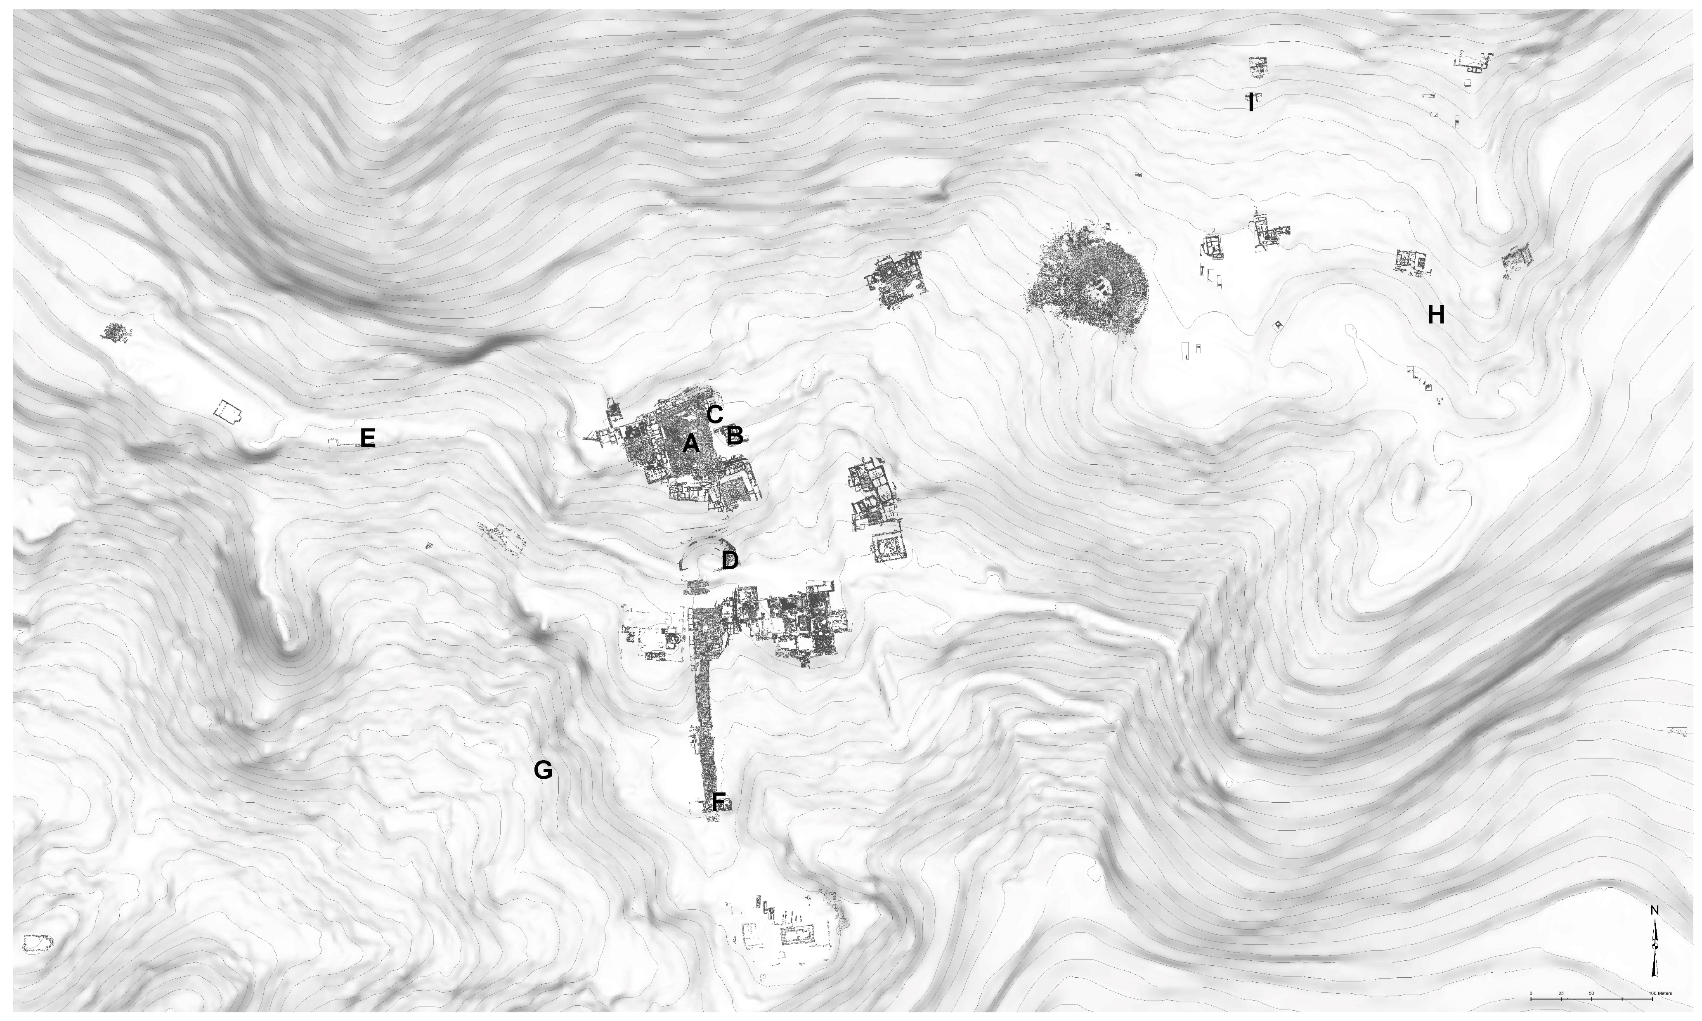
The Polis in Anatolia: Düzen Tepe and Sagalassos
Notes:
On a micro level, I will highlight the example of two communities…
Properties of polis formation identified at Sagalassos:
New forms of social organization, socio-political structures and institutions
Development of social, political and economic elite
New forms of material culture and monumental architecture
Territorial extension

Slide 5
Designing Models
Model properties:
Representation (what?)
Simplification (how?)
Purpose (why?)
What? Origin and development of poleis in Anatolia
How? Focus on key properties:
Fusion-fission cycles
Urban scaling
Centrality
Why?
Untapped potential of computational modelling approaches in Classical Archaeology
Testing existing hypotheses and exploring possibility space
Notes:
Simplification
What you put in your model depends on your questions
There are many reasons why modelling can be useful, I will address several throughout this talk, but would like to highlight two elements here…

Slide 6
Conceptual Modelling
“A model that is made of ideas or concepts is called a conceptual model” (Gonzalez-Perez 2018)
Focus on dynamics within and between communities:
Intra-community dynamics
Community fission
Urban scaling
Inter-community dynamics
Community fusion
Central places and networks
Gonzalez-Perez (2018) Information Modelling for Archaeology and Anthropology.
Notes:
You can call it conceptual modelling or the conceptual design of the model
Focus on settlement-level dynamics

Slide 7
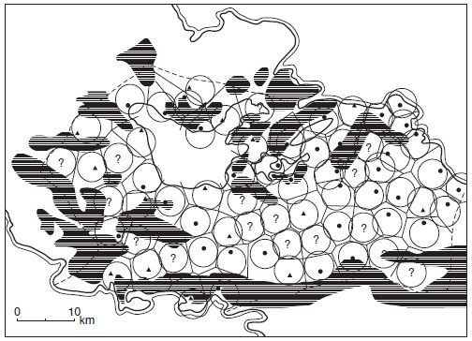
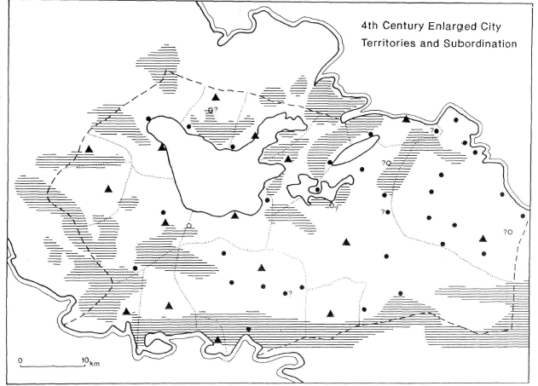
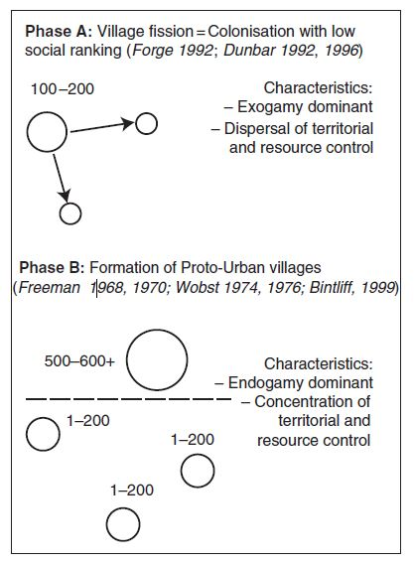
Conceptual Model: Fusion-Fission Cycles
Bintliff (1982) Settlement Patters, land tenure and social structure: a diachronic model.
Bintliff (1994) Territorial behaviour and the natural history of the Greek polis.
Bintliff et al. (2007) Emergent complexity in settlement systems and urban transformations.
Notes:
Fission: landscape-filling
Fusion & increasing group sizes → polis formation
Territorial extension
New forms of social organization, socio-political structures and institutions
Development of social, political and economic elite
New forms of material culture and monumental architecture
CONTINGENCY

Slide 8
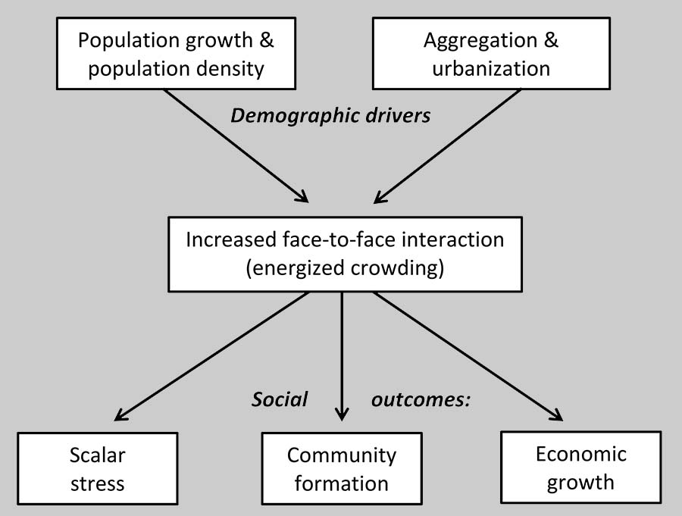
Conceptual Model: (Urban) Scaling
Population growth and concentration as one of main drivers of societal development
Face-to-face interaction and information transmission
Settlements as ‘pockets of interaction’ or ‘social reactors’
As community sizes increase, ‘social outcomes’ grow as well
Processes span urban-nonurban divide
Bettencourt (2013) The Origins of Scaling in Cities
Ortman and Cofey (2015) Universal Scaling: Evidence from Village-Level Societies.
Smith (2019) Energized Crowding and the Generative Role of Settlement Aggregation and Urbanization
Smith 2019
Notes:
To find an explanation of underlying process → look at urban scaling
People come together → more interactions → more ‘outcomes’
Process operates in both villages (aggregation) and cities (urbanization)
“energized crowding” < architectural historian Spiro Kostof
Scalar stress can result in fission (cfr. Previous)
Major outcomes of scalar stress in villages and early cities: fission, specialization in roles, development of social hierarchies, and increased group-integrating
ritual activity
Community formation → social organisation → allows increase in group size

Slide 9
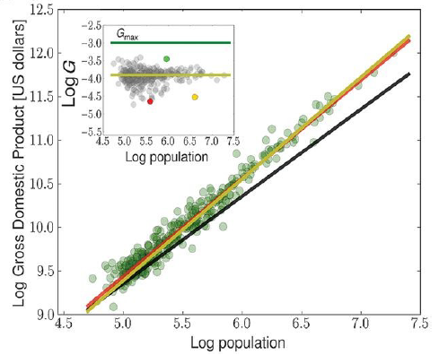
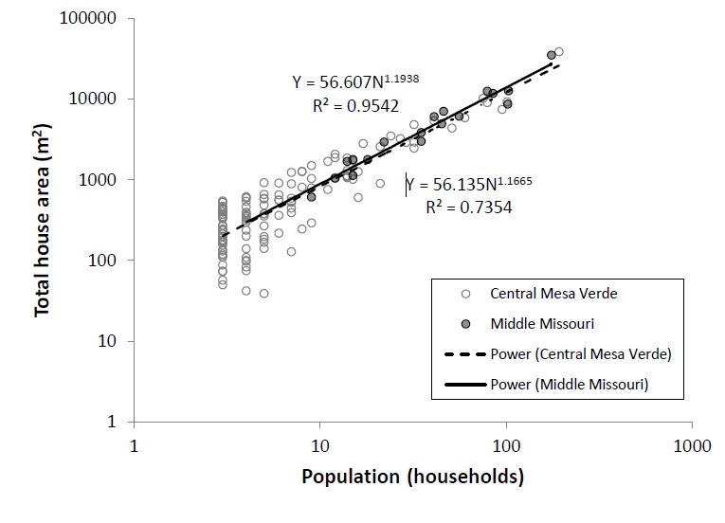
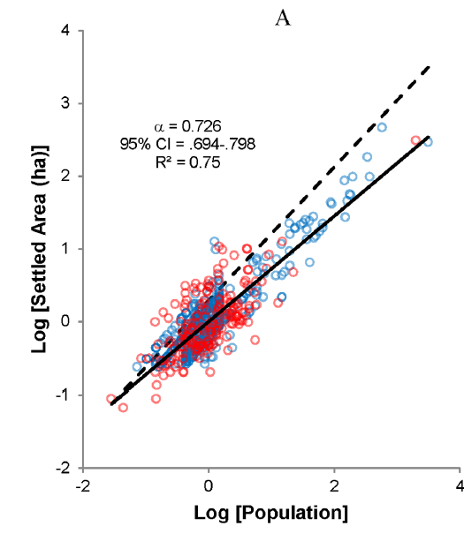
Conceptual Model: (Urban) Scaling
Bettencourt (2013) The Origins of Scaling in Cities.
Ortman & Cofey (2015) Universal Scaling: Evidence from Village-Level Societies.
Ortman et al. (2014) The Pre-History of Urban Scaling.
𝑋 = 𝑋₀𝑁^{α}
Notes:
Scaling research generates these characteristic plots:
Scaling laws are commonly expressed for some property of interest against population size
Superlinear: Gross metropolitan product of metropolitan areas in 2006 (Bettencourt 2013)
ex. Socio-economic output: income, wealth, innovation ; but also crime and poverty
Linear: Relationship between village population and total productivity. (Ortman & Coffey 2015)
ex.: number of houses
Sublinear: Population vs. Settled Area for Aztec settlements (Ortman et al. 2014)
→ infrastructure

Slide 10
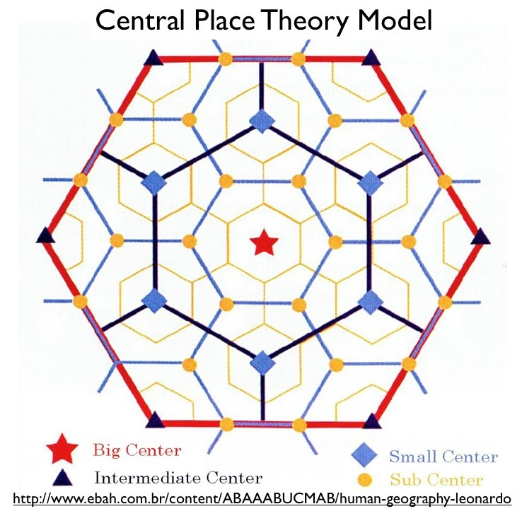
Conceptual Model: Central Places
Larger community ~ more diversity in activities/functions (Hanson et al. 2017)
Spatial concentration of functions in settlement systems (Christaller 1933)
Centrality in network hierarchies:
Qualitative and quantitative
(1) administration; (2) security; (3) craft and industry; (4) trade; and (5) cult (Gringmuth-Dallmer 1996)
Christaller (1933) Die Zentralen Orte in Süddeutschland
Gringmuth-Dallmer (1996) Kulturlandschaftsmuster und Siedlungssysteme.
Hanson et al. (2017) Urbanism and the division of labour in the Roman Empire
Notes:
One application of scaling laws on Roman cities concluded that larger communities have more diversity in functions (= division of labour)
𝐹 = 𝑘(𝑁) × 𝑑(𝑁) ➔ total number of functions = individual’s social contacts x range of functions they perform
More different activities in larger communities: range of tasks that an individual performs is inversely proportional to their social contacts (Hanson et al 2017)
Not in detail, but total functional diversity of a settlement increases more slowly than population (sublinear) and at the same rate as areal extent increases
When looking at higher functional diversity in larger settlements on the scale of settlement system → spatial concentration of activities in central places
Central Place Theory: Each central function has an upper limit (determined by the maximum distance people will travel to access it) and lower limit (determined by the minimum population required to sustain a central function).
More functions = higher order; less = lower-order
Not just central places (i.e. qualitative functional differences) but also degree of centrality (quantitative strength of pulling forces of settlement onto environment)
central place theory and central flow are complementary to each other ➔ resulting in idea of ‘network centrality’

Slide 11
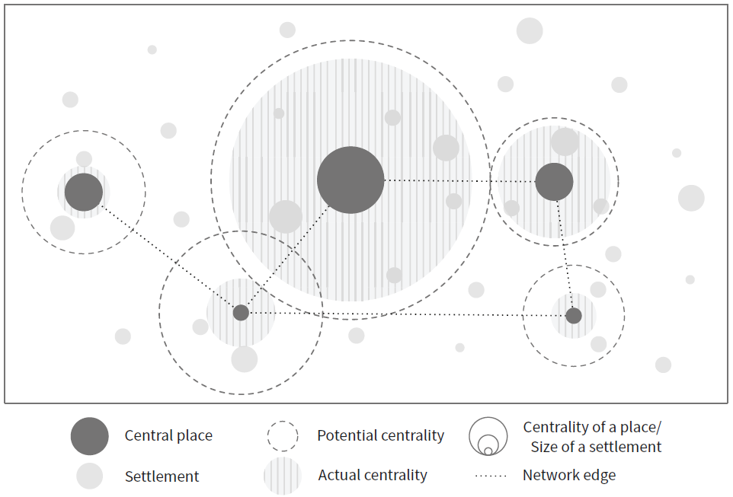
Conceptual Model: Central Places
“Relative concentration of interaction”
Network approach: Places and flows
Pulling factors for potential centrality
Population size, natural resources, strategic location, administrative institutions, cultural functions, high carrying capacity, ritual features, etc. (Knitter and Nakoins 2018)
Knitter & Nakoinz (2018) The Relative Concentration of Interaction
Notes:
Potential versus actual pulling power → way to model contingency of polis formation!

Slide 12
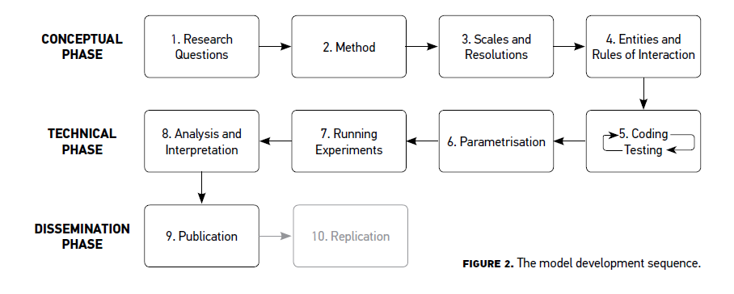
Computational Model: Simulations
Conceptual phase
Identifying research questions
Finding most suitable method
General framework and resolution of simulation
Entities and rules of interactions
Technical phase
Coding and testing
Parameterising simulation
Running simulation
Analysis and recontextualization of results
Dissemination phase
Disseminate findings
Romanowska (2015) So You Think You Can Model?
Notes:
So far for the conceptual model, now what should we do if we want to translate this into a computational model and build a simulation?

Slide 13
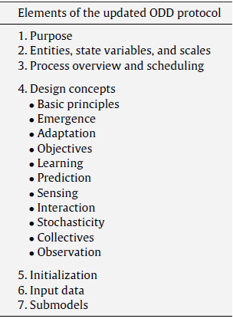
Computational Model: Documentation
ODD protocol: standardize the published descriptions of individual-based and agent-based models (Grimm et al. 2010)
Iterated process
Structure thoughts
Think through construction of the model
Purpose:
Study the emergence of polis communities out of fusion-fission dynamics and urban scaling processes; and trace their development into central places through network formation
“Agent-based models make possible the study of nonlinear cultural dynamics that emerge from the historically contingent actions of heterogeneous agents interacting in space” (Premo 2006)
Grimm et al. (2010) The ODD protocol: A review and first update
Premo (2006) Agent-based models as behavioral laboratories
Notes:
ODD = Overview, Design concepts and Details
Goal: standardize the published descriptions of individual-based and agent-based models
Many elements of ODD will feature throughout the remainder of this talk. Just a quick word on the purpose of the model
ABM: deal with Bintliff’s problem of CONTINGENCY!

Slide 14
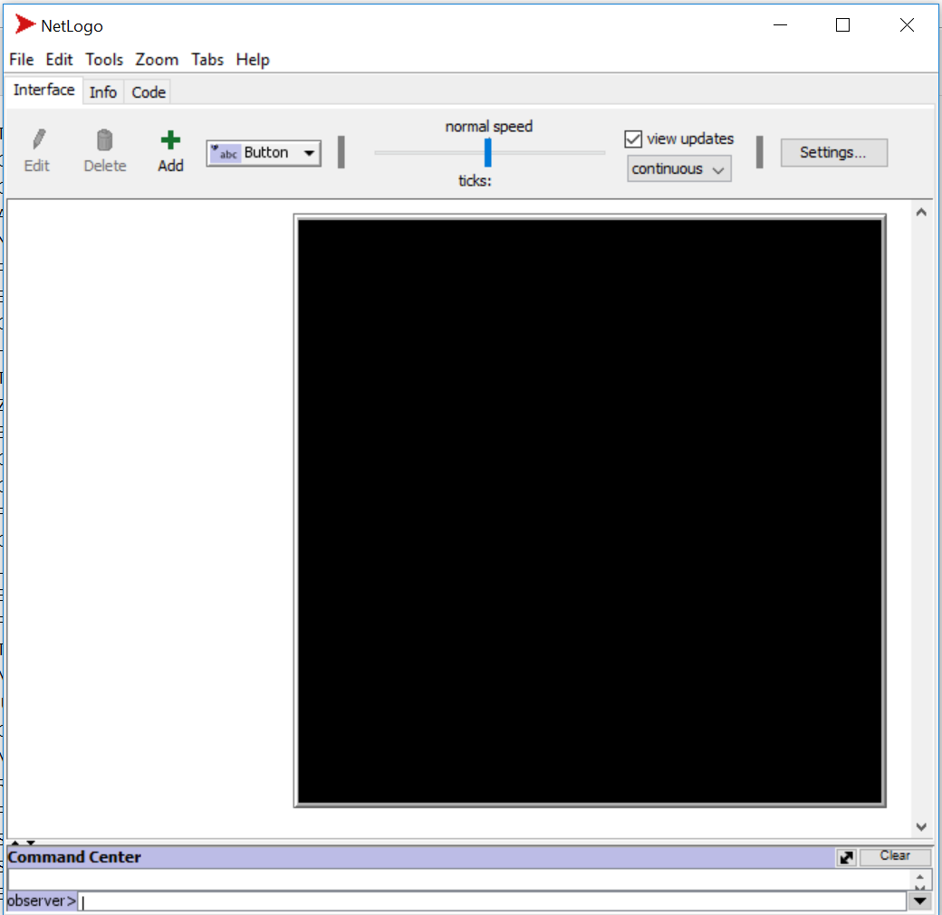
ABM: Polis Formation
Software: NetLogo (Wilensky 1999)
From conceptual to detailed design:
Translating the conceptualised system into a set of entities and rules of interaction
Input and output information per component
Scale and resolution
Operational design
Pseudo-code
Coding
Edmonds and Meyer (2013) Simulating Social Complexity
Gonzalez-Perez (2018) Information Modelling for Archaeology and Anthropology
Wilensky (1999) NetLogo. http://ccl.northwestern.edu/netlogo/.
Notes:
So, with all that being said, how do we move on to develop an agent-based model?

Slide 15
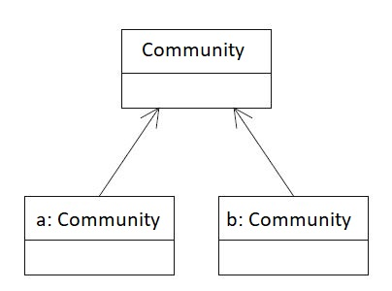
Simulation Design
Class: community
Notes:
Idea is to build the model from the ground starting with very basic premises
→ Starting with a focus on communities as main agents

Slide 16
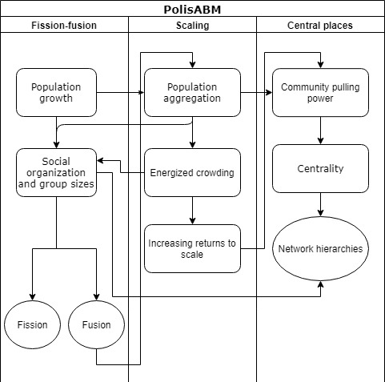
Process overview
Settlement dynamics
Fission-fusion
Energized crowding
Centrality and network formation
Notes:
Process flows and feedback loops

Slide 17
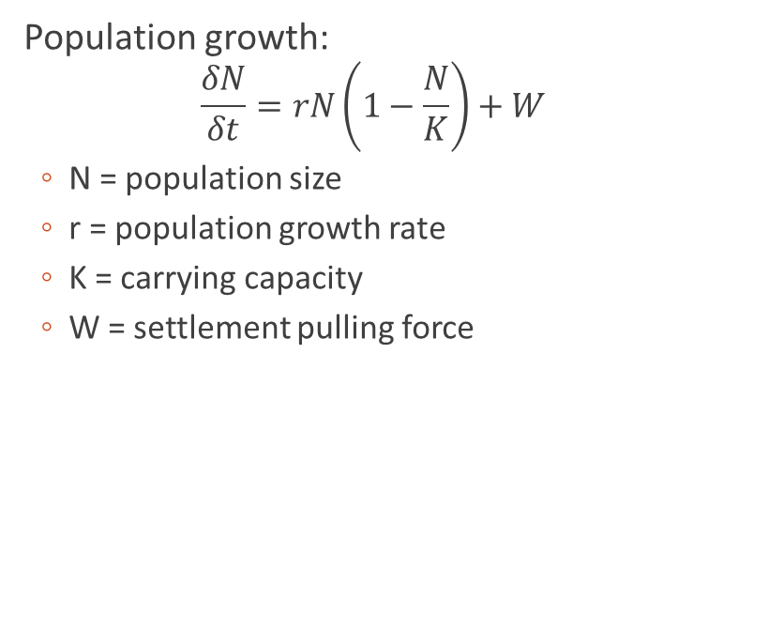
Simulating Fission-Fusion Cycles
Polities expand in size over time due to population growth
Group fission occurs with certain chance once population threshold is reached and empty space is available
If no space for expansion
Fusion process
‘Conquest’
Fusion can occur when adjacent polities of similar size come into conflict when no empty land separating them remained for expansion
Population growth:
$$\frac{δN}{δt}=rN\left(1−\frac{N}{K}\right)+W$$
N = population size
r = population growth rate
K = carrying capacity
W = settlement pulling force
Griffin (2011) Emergence of fusion/fission cycling
Notes:
Carrying capacity: poses a limit to population growth that can be solved by expanding territory, fusion, or conquest
Population threshold = 500
Conquest → development of hierarchies

Slide 18
Simulating Scaling
Original social reactor model:
Number of people over a settled area
Energetic constraints and costs of travel distance
Probabilities they will encounter other people
Average output or productivity per person
(Bettencourt 2013; Smith 2019)
Parameters:
Number of people
Size settlement/territory
Average settlement output
A(N) = aN^{α}
A = settled area
a = constant for benefit interaction / cost per unit time & space
N = population size
α = scaling exponent (2/3 for sublinear output)
𝑋 = x𝑁^{𝛽}
𝑋 = aggregate of socio-economic output
N = population size
𝛽 = scaling exponent (7/6 for superlinear output)
Notes:
Travel distance & probability of encounters: given a set of energetic constraints, people arrange themselves in space and create infrastructural networks so as to balance the costs of moving around with the benefits of the resulting interactions → coefficient a reflecting a baseline area per population unit or individual
Research shows: coefficient for settlement growth ranges from 2/3 for unstructured settlements to 5/6 for sites with network infrastructure
All settlements start with 2/3 exponent
Exponent 𝛽 is typically about 5/6 when 𝑋 is a measure of infrastructure or the division of labor, and about 7/6 when 𝑋 is a measure of aggregate interaction or socio-economic output.

Slide 19
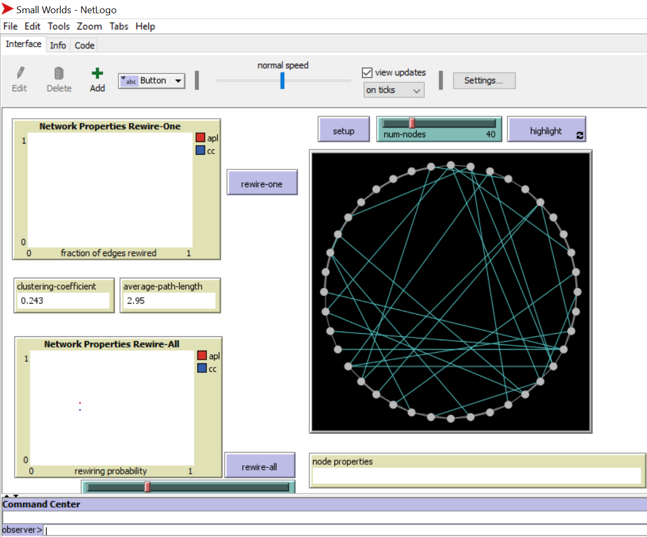
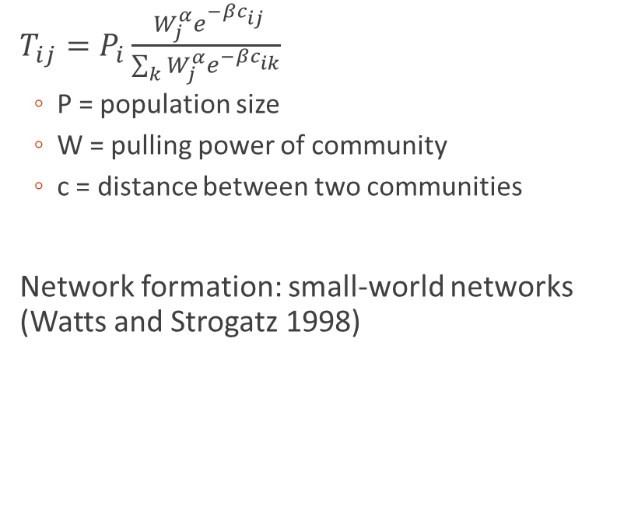
Simulating Central Places and Networks
Pulling forces of a community (Wilson and Rihll 1987)
Population size: larger communities exercise bigger influence
‘Weight’ of community
Network formation
Neighbouring ties
Production output as ‘capital’ to initiate long-distance connections and increase pulling power over other communities
$T_{ij}=P_{i}\frac{ W_{j}^{α}e^{−βc_{ij}}}{\sum_{k}{W_{j}^{α}e^{−βc_{ik}}}}$
P = population size
W = pulling power of community
c = distance between two communities
Network formation: small-world networks (Watts and Strogatz 1998)
Watts and Strogatz (1998) Collective dynamics of ‘small-world’ networks
Wilson, A. G., & Rihll, T. E. (1987). Spatial Interaction and Structural Models in Historical Analysis.
Notes:
General spatial interaction and location model by Wilson and Rihll applied entropy maximizing on polis formation in 8th century Greece
so-called retail model simulating flows between communities, measured based on sizes
Exponent alpha is a parameter used to represent the importance of attractiveness of a site- if greater than 1, representing increasing returns to scale;
→ b is a parameter used to represent the decay of effective communication with increasing distance.

Slide 20
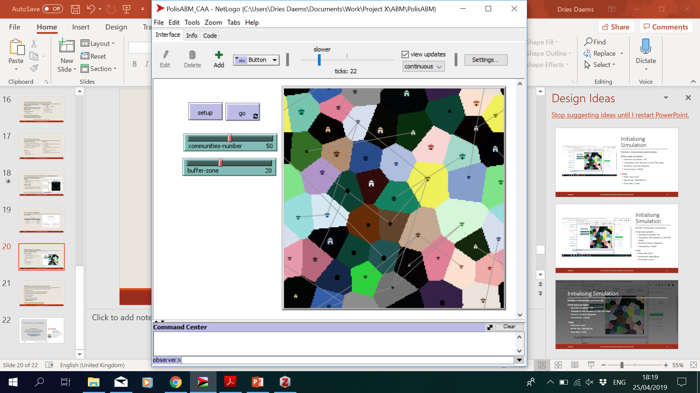
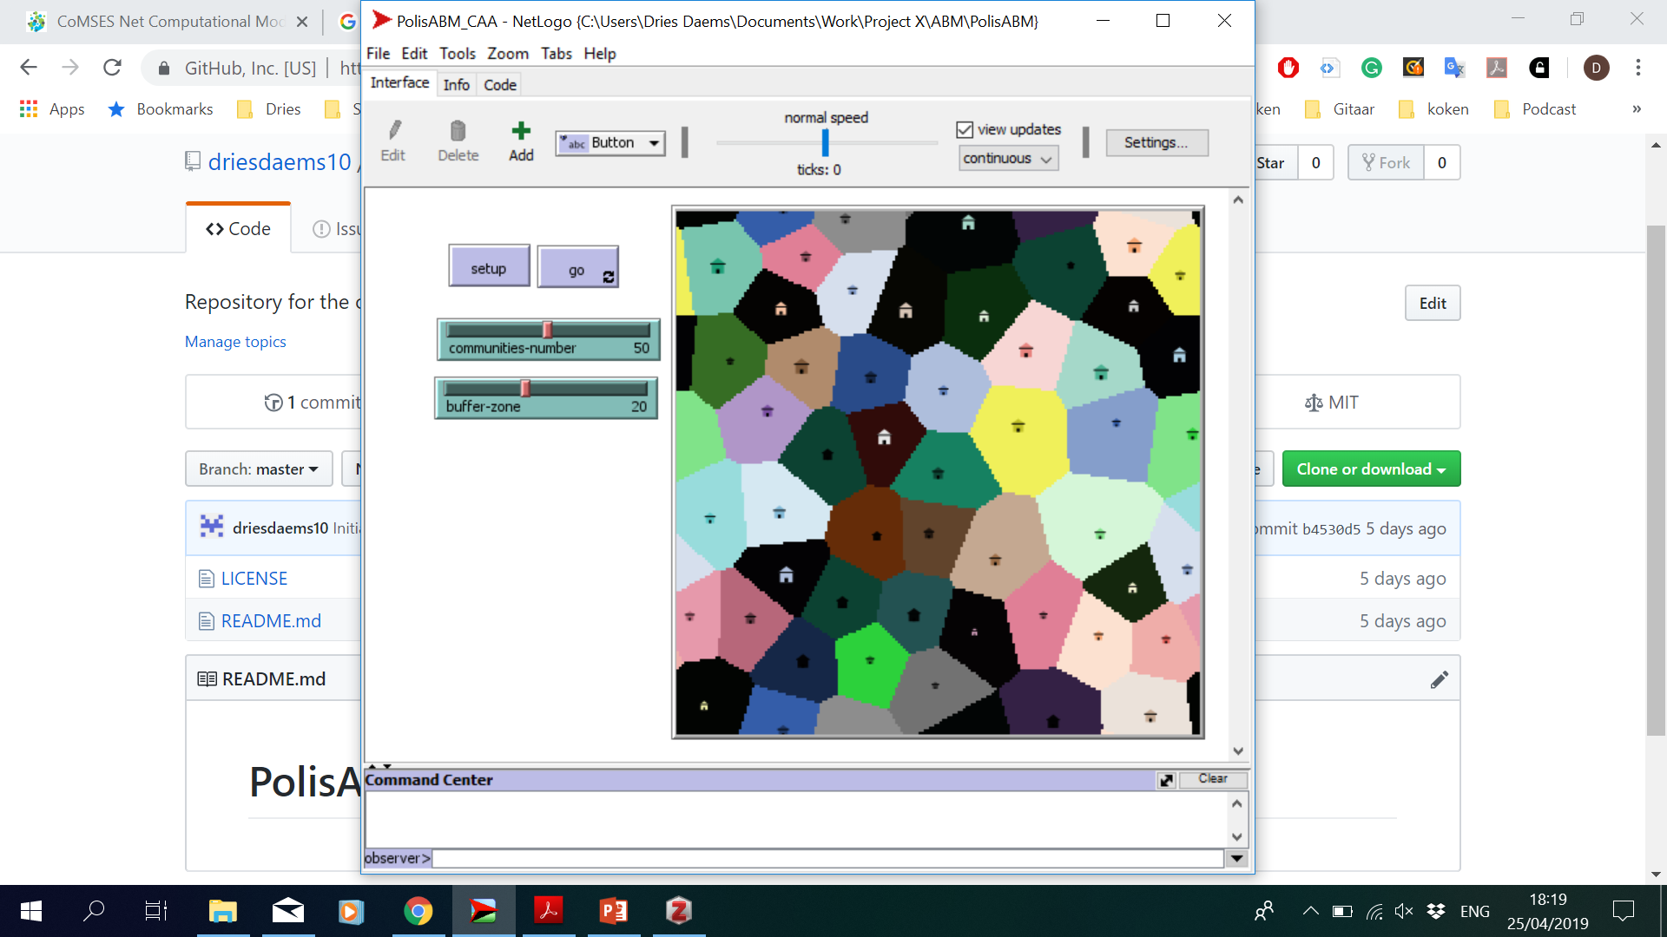
Initialising Simulation
Entities = (corporate) communities
Initial state variables:
Number of polities = 50
Population size: Random in 250-750 range
Territory: Voronoi Diagrams
Connections = FALSE
Scale
Patch size: 1km²
World size: 100x100 km
Time step: 1 year
Network formation

Slide 21
Potential Future Development
Starting point for future development to extend/refine model:
Micro-scale dynamics:
Generate energized crowding output from social interactions
Implement fission/fusion cycles according to scaling parameters
Macro-scale dynamics
Royal policy stimuli
Human-environment interactions
Energy capture and expenditure
Settlement chambers
Code and documentation will be made available: https://github.com/driesdaems10/PolisABM
Notes:
Micro-scale: interaction and movement within community: more detailed assessments of benefit and energetic costs
Macro-scale: inclusion of dynamics beyond the settlement level
For now: spatially abstract model. No point in including real GIS-based landscape, but some more environmentally-informed baselayer could be included

Slide 22
Thank you for your attention!
Dr. Dries Daems
Suna & Inan Kıraç Research Centre for Mediterranean Civilizations (Koç University)
Sagalassos Project (KU Leuven)
dries.daems@kuleuven.be
@DriesDaems

